Slide 1

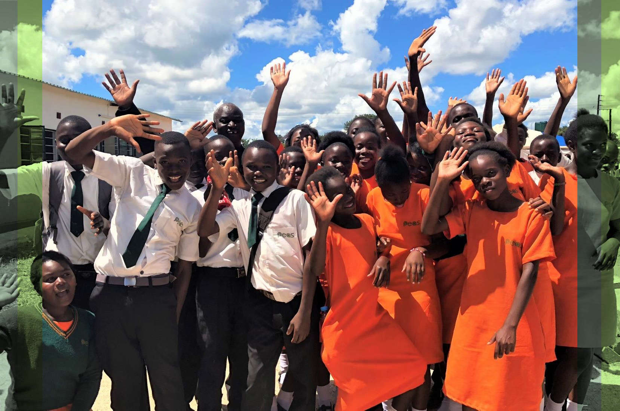
Global Technology & Operations Lead
Candidate Pack
Our Mission
To expand access to sustainably delivered quality secondary education across Africa
1
www.peas.org.uk

Slide 2

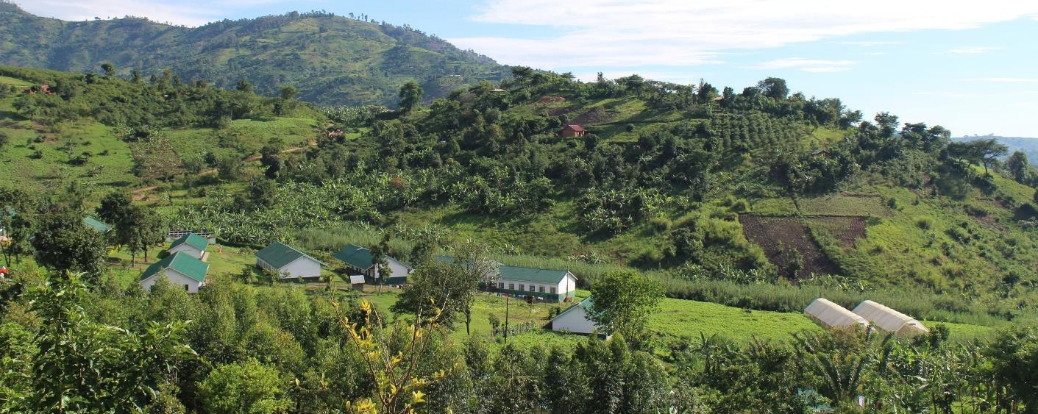
About us
PEAS is transforming education across sub-Saharan Africa. By 2035, the number of sub-Saharan Africans reaching working age will exceed that of the rest of the world combined. Yet today, the sub-continent has the world’s lowest secondary school completion rates. Schools are under-resourced, with low quality teaching and unsafe learning environments. PEAS is addressing this by expanding access to inclusive, quality secondary education so all children can enjoy an education that unlocks their full potential. At the heart of our work are 44 exemplar PEAS schools, delivering outstanding and affordable education to 25,000 young people in hard-to-reach communities across Uganda and Zambia. But if all children are to benefit, that doesn’t go far enough. So, we draw on our 16 years practical experience to partner with governments to design, deliver and embed country-wide meaningful changes to improve education. This year we will support over quarter of a million young people in Uganda, Zambia and Ghana. Evidence shows our students come from poorer households, feel safer and make faster learning progress. Our girls are more confident and better equipped for life after school. We achieve all this at a lower cost than alternatives.
What makes PEAS different?
Reducing reliance on international aid:
Philanthropic funding means our schools open debt free they then generate local income to cover ongoing running costs
Our system strengthening programmes are co-designed with government to fit within ministry budgets
Rooted in local expertise, delivering global excellence:
Our schools and country offices have always been fully staffed and led by Africans.
We are governed by a Board that is majority African and female, with a majority African Global Leadership Team
Our award-winning programmes are created by Africans, for African communities, and shaped by the voices of those they serve

Slide 3



The Opportunity
Role and department | Global Technology & Operations Lead, Operations
Role purpose | Lead on the end-to-end delivery of complex digital solutions that meet user needs and drive organisational impact
Contract | 12 months parental cover – open to part-time and flexible working arrangements
Compensation | Competitive – dependent on seniority, experience and location
Location | We welcome applicants from UK, Uganda or Zambia, and will consider fully remote applicants. London-based staff can engage in hybrid working (1-2 days working in London office)
Start date | February or March 2026
PEAS’ strategy centres on growth and innovation, with technology as a key enabler. By using digital tools, we can improve the quality of support we provide to students, teachers and government partners in a cost-effective manner. Technology streamlines processes, unlocks the full potential of impact data and enhances collaboration, driving organisational efficiency which will allow us to scale our impact across Africa. We are seeking a Technology & Operations Lead to support this exciting work.
About the PEAS Global Technology Team
As Global Technology & Operations Lead, you’ll join a small but mighty Technology team within Global Operations. This team combines a passion for using technology to improve delivery, technical expertise and strong project management to serve as the driving force behind our technology projects. They work directly with our in-country teams and technology partners to design and deliver products that give staff the information and systems they need to achieve operational excellence and programmatic impact.
Some examples of initiatives from 2025:
SchoolTool+ is PEAS’ bespoke school management platform, developed in-house and designed for low-resource environments. It enables school leaders and teachers to capture and analyse data on enrolment, attendance and performance to make data-driven decisions every day.
For the past 15 months, PEAS has been building our data platform to bring together our rich array of data sources - such as school visit reports, inspections and operational metrics - into one integrated system. This enables real-time analytics for our teams to monitor progress and adapt strategies quickly, ensuring decisions are based on accurate information. The platform underpins PEAS’ ambition to become a leading data-driven organisation.
PEAS has recently embarked on the development of a new mobile app to digitise PEAS’ instructional leadership model – the ‘Top 10 for Teachers’. The app will provide short videos, practical guides and tools for feedback, helping school leaders deliver high-quality professional development.
PEAS is in the process of rolling out SmartOps – a new enterprise resource planning tool streamlining operations across finance, procurement, HR and grant management. By replacing manual processes with automated workflows, SmartOps reduces delays, improves data accuracy, and enhances reporting.
In 2025, PEAS has been investing in assessing and licensing of AI tools to help colleagues work smarter within a secure, cost-effective framework.

Slide 4

Responsibilities of the Role
As Global Technology & Operations Lead, you will lead on the end-to-end delivery of complex digital solutions that meet user needs and drive organisational impact. You will work closely with global and in-country colleagues and our technology partners to design and deliver products that shape the future of our digital landscape at PEAS. This is a strategic, high-impact role for someone who can think systemically, collaborate across teams and balance big-picture design with hands-on delivery.
The exact scope of the role will be adjusted depending on the seniority and experience of the successful candidate; however, key responsibilities will include:
Product management of key technology initiatives
Lead the end-to-end delivery of priority EdTech and operational technologies, from initial scoping and horizon mapping through to implementation and evaluation.
Work with global and in‑country teams to prioritise technology needs and define clear objectives, success measures and timelines.
Run structured vendor assessments following PEAS’ procurement guidelines to identify partners for sourcing or developing tools, including initial assessment, shortlisting and due diligence.
Lead user research and translate insights into clear, testable requirements across teams; maintain a living backlog and roadmap.
Manage delivery and relationships with selected vendors to keep projects on time, on budget and to quality, resolving risks and issues promptly.
Plan and coordinate roll out, training and communications for new tools; support adoption through practical guidance, FAQs and bite‑size materials.
Track usage and performance, collect adoption and impact data, and share insights with stakeholders to inform iteration and the next wave of priorities.
Example projects may include the Top 10 app, AI usage and future SchoolTool+ sprints. The exact portfolio will be tailored to the successful candidate’s seniority and experience.
Strategy development support
Contribute to PEAS’ next organisational strategy, shaping future technology priorities and working with the Global Technology team and in-country colleagues to set a clear three-to-five-year implementation roadmap;
Lead on the communication of PEAS’ Technology strategy to internal and external stakeholders, to build support and understanding.
Continuously track developments in relevant technology and feed regular insights into decision‑making, ensuring our technology roadmap remains relevant.
Fundraising for technology initiatives
Work with fundraising colleagues in the Development team to craft compelling proposals and budgets for funders interested in our technology initiatives;
Join funder meetings to present on projects and provide material for reports;
Proactively identify potential funders from networks.
General support for operational excellence initiatives
Dependent on organisational need and skillset of successful applicant, supporting with broader operational initiatives.
The above list provides a framework of responsibilities but should not be viewed as a definitive list, there may be other reasonable responsibilities required aligned to the role.

Slide 5
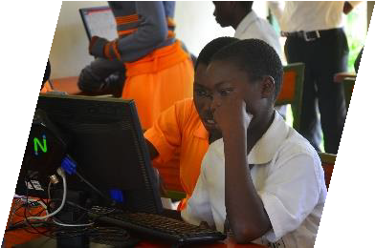
Who we are looking for
Someone who has…
A degree or equivalent relevant work experience.
At least 5 years experience in working in relevant technology roles, either in the international development sector, social enterprises or corporates.
Proven track record of delivering complex, multi-stakeholder technology projects and products at strategic and operational levels, with knowledge of change management processes.
Demonstrated ability to translate user needs into technical requirements, prioritising effectively across competing demands.
Excellent project management, prioritisation and communication skills - able to bridge technical and non-technical audiences.
Excellent IT skills, including Microsoft Office productivity tools.
Working knowledge of core technology concepts, such as databases, software development approaches, enterprise resource planning tools, CRMs and connecting technologies across systems.
Knowledge of security, privacy and compliance frameworks (e.g. GDPR) as they apply to digital systems.
Experience managing relationships with technical vendors.
Strong people skills and an appreciation for how culture and collaboration contribute to organisational goals.
Experience working with international teams, ideally relevant experience in Sub-Saharan African (desirable).
Ability to undertake international travel for 2 to 4 weeks per year.
And who is…
Values aligned and passionate about improving the life chances of all children through educational opportunity.
A self-starter – adaptable, shows initiative and is proactive in finding solutions.
Creative and resourceful – able to find ways to deliver high returns on a small budget.
Collaborative not competitive - interpersonal and communication skills to build relationships with peers across multiple departments across multiple countries.
Resilient and professional – works well under pressure, deals with challenges professionally and calmly and doesn’t let setbacks hold them back.
Open minded – willing to listen to others and consider new ways of approaching problems.
Zero ego – prepared to get stuck in.
Curious and eager to learn, especially when working with new systems or digital tools.
Patient and empathetic when supporting colleagues with varying levels of technical comfort.
Detail aware, taking care to keep information accurate and well organised.
Attentive to how processes work and comfortable offering practical suggestions to make tasks easier.
5

Slide 6

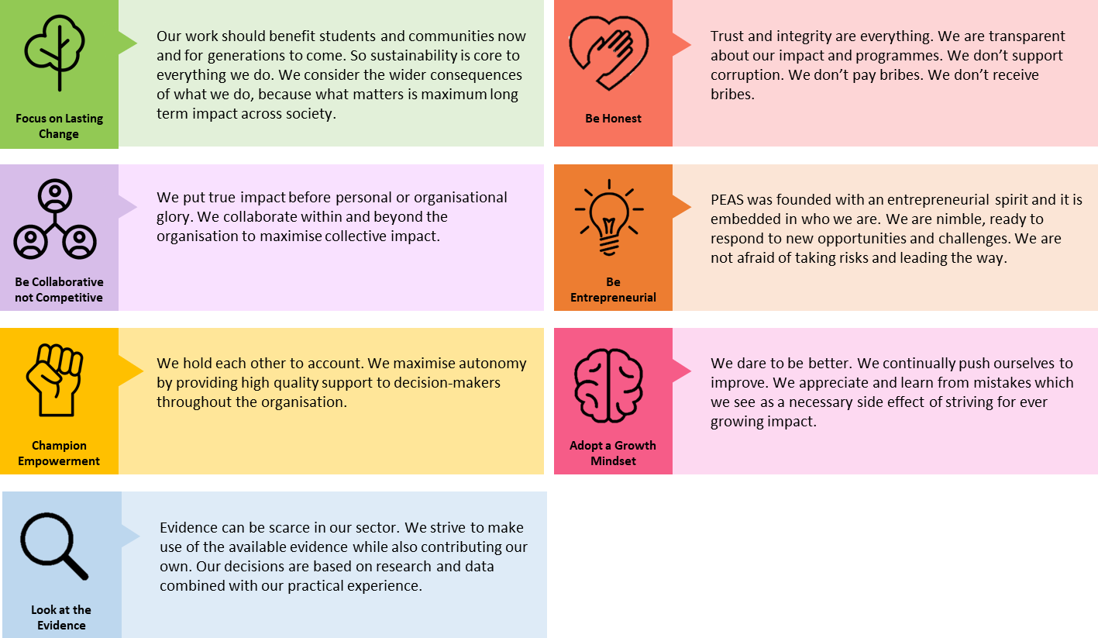
Our values
How to apply To apply, please complete this application form. Applications will be reviewed on a rolling basis from 9am Wednesday 7th January. <Add something about here about using a new system, if we decide to go with SmartOps?> Due to high volumes of applications, if you have not heard from us within 2 weeks of the closing date, please assume you have been unsuccessful on this occasion. We are committed to ensuring our opportunities are accessible to all, so if there is any way that we can support you to be the best you can be in the recruitment process, please do get in touch by e-mail on info@peas.org.uk. We welcome all applicants and will always treat every application fairly based on merit.
PEAS is highly committed to keeping children safe from harm and preventing corruption. We therefore take our responsibility to promote safe recruitment practices very seriously, including conducting appropriate reference and background checks. We also operate a zero-tolerance approach to any PEAS employees who breach our Safeguarding and Anti-Corruption Policies, which all employees are required to sign upon induction. PEAS is an equal opportunity employer that does not discriminate in its recruitment practices and, in order to build the strongest possible workforce, actively seeks a diverse applicant pool.
6

